Slide 1
TEAM Double Trouble
ANIRUDHI tHANVI (Team Leader , Developer)
RAGHAV SHARMA (Software Developer)

Slide 2
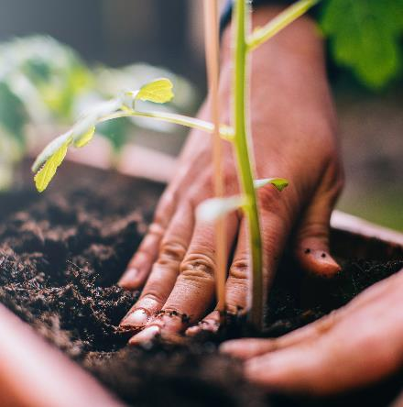
PROBLEM ADDRESSED
Global Call to solve Agricultural Problems
Farmer’s face many problems related to the crop and their production.
Unavailability of good quality of seeds and crops
Gardener’s Lack in latest techniques and proper guidance
Lack of nurseries nearby

Slide 3

Solution – our Idea !!
Tomato Plant Leaf Disease Detection
The leaf of tomato crop suffers from different diseases, mainly late blight, Septorial leaf spot, bacterial leaf spot, yellow leaf curl, leaf mold manual, tomato mosaic and early blight. Plant diseases have turned into a big problem as it can cause significant reduction in both quality and quantity of agricultural products. The idea behind tomato plant leaf detection is to identify the disease on an early stage so that quality and quantity of agricultural products.

Slide 4
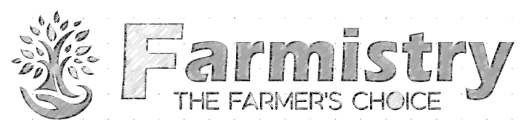
Facilities
Agropedia
Gardening Tips
Plant Disease Detection
Soil Quality Prediction
Expert Guided Solutions
Quality Seeds & Hardware Products
Online Nursery
Virtual Stores

Slide 5
Technology used :
Frontend
HTML
CSS
Backend
Python
MySQL
Bootstrap
Javascript
PHP
Machine Learning

Slide 6
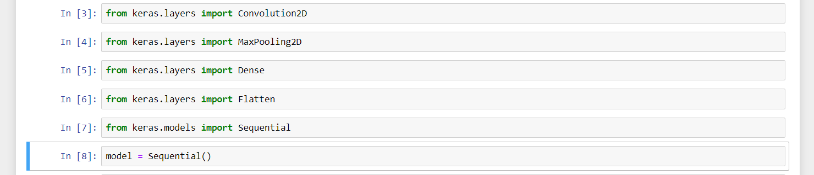
Libraries & Models Used

Slide 7
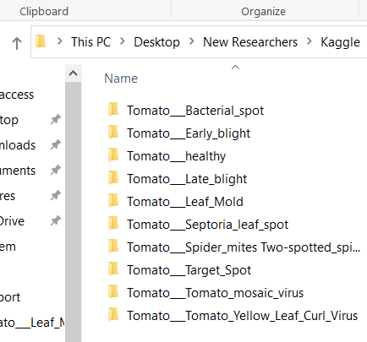
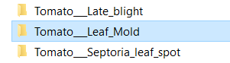
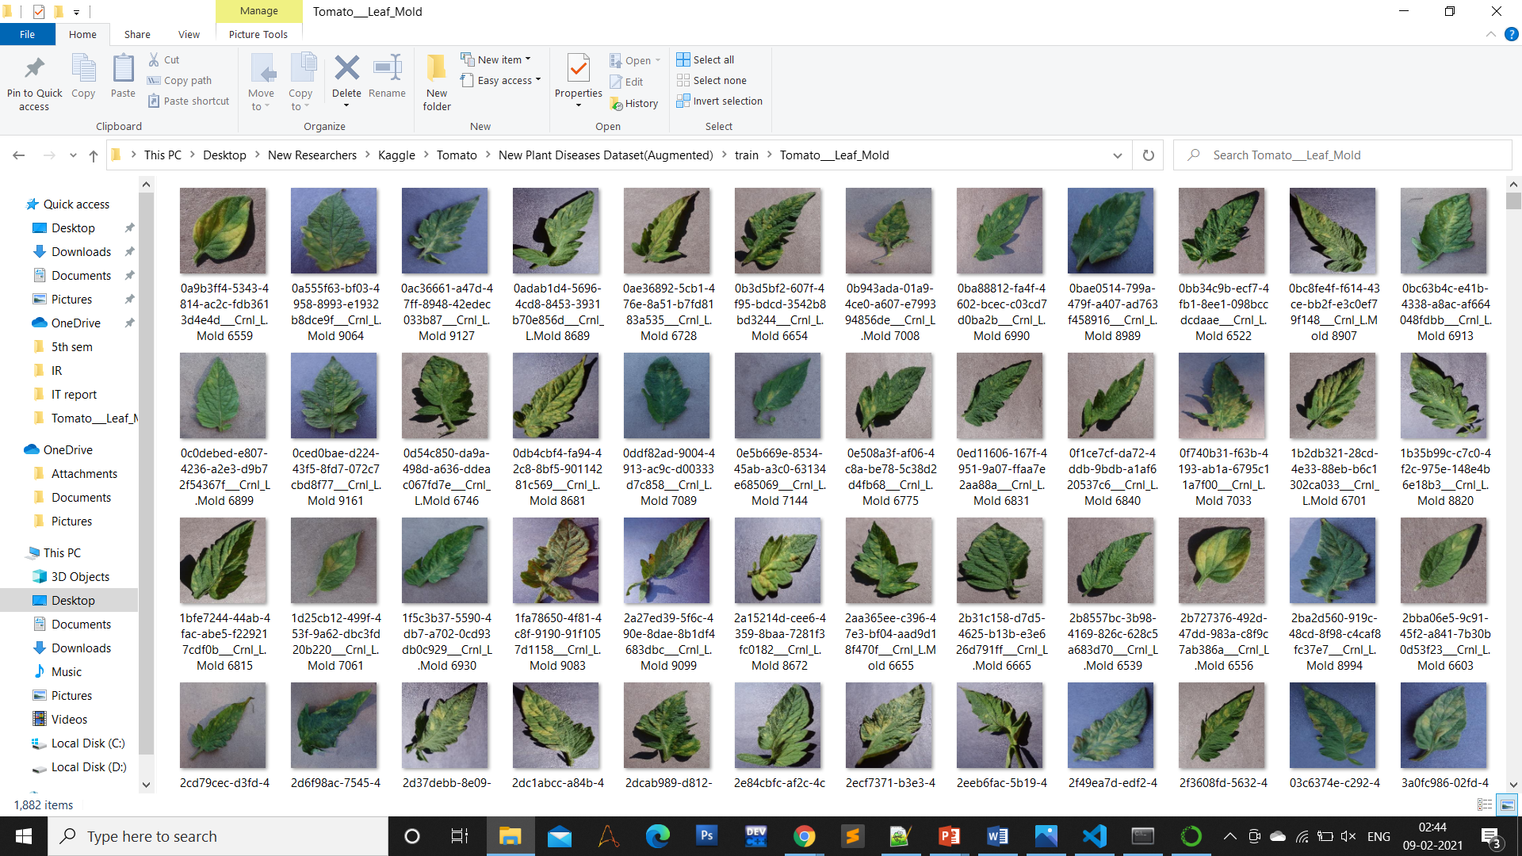
Training Image Dataset

Slide 8
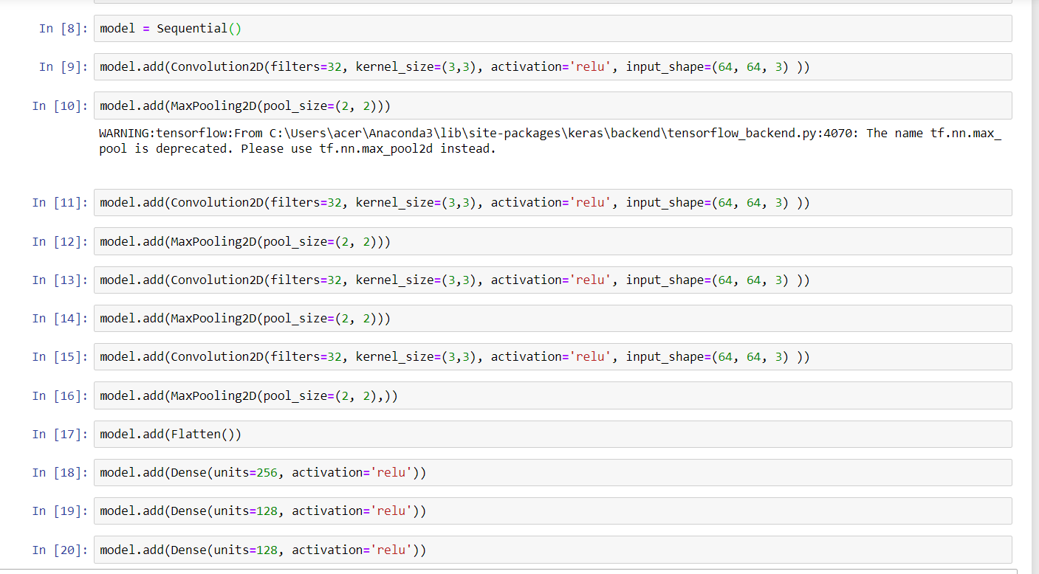
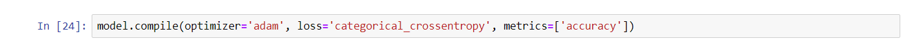
Model Build
Compiling the Model

Slide 9
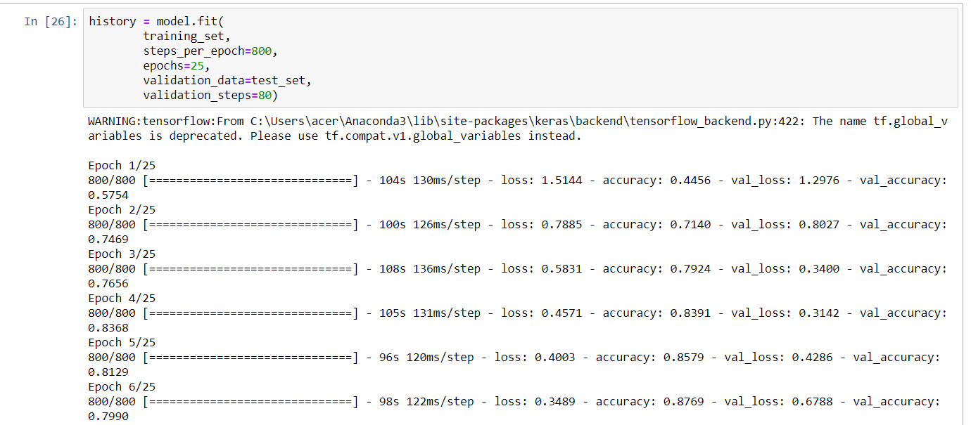
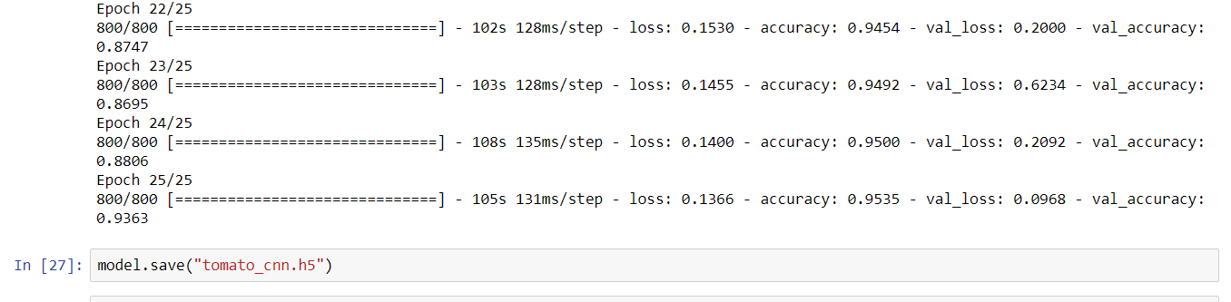
Model Compile & Save
Fitting the Model
Saving Weights

Slide 10
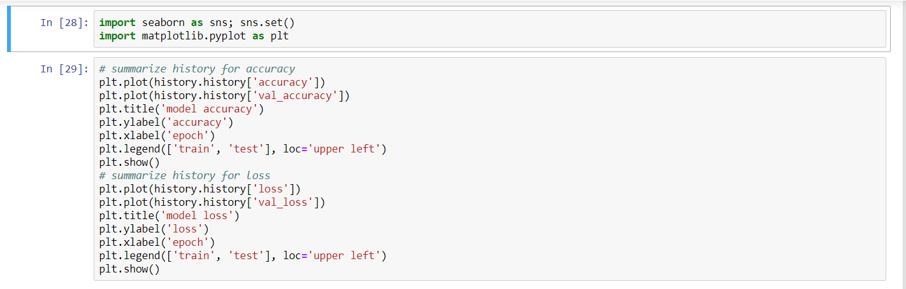
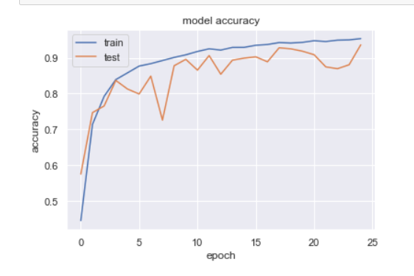
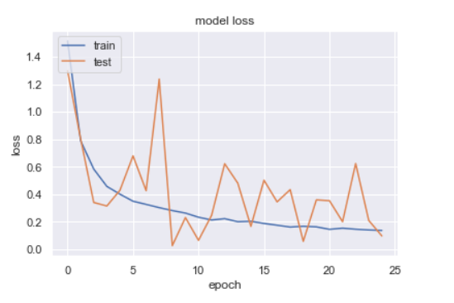
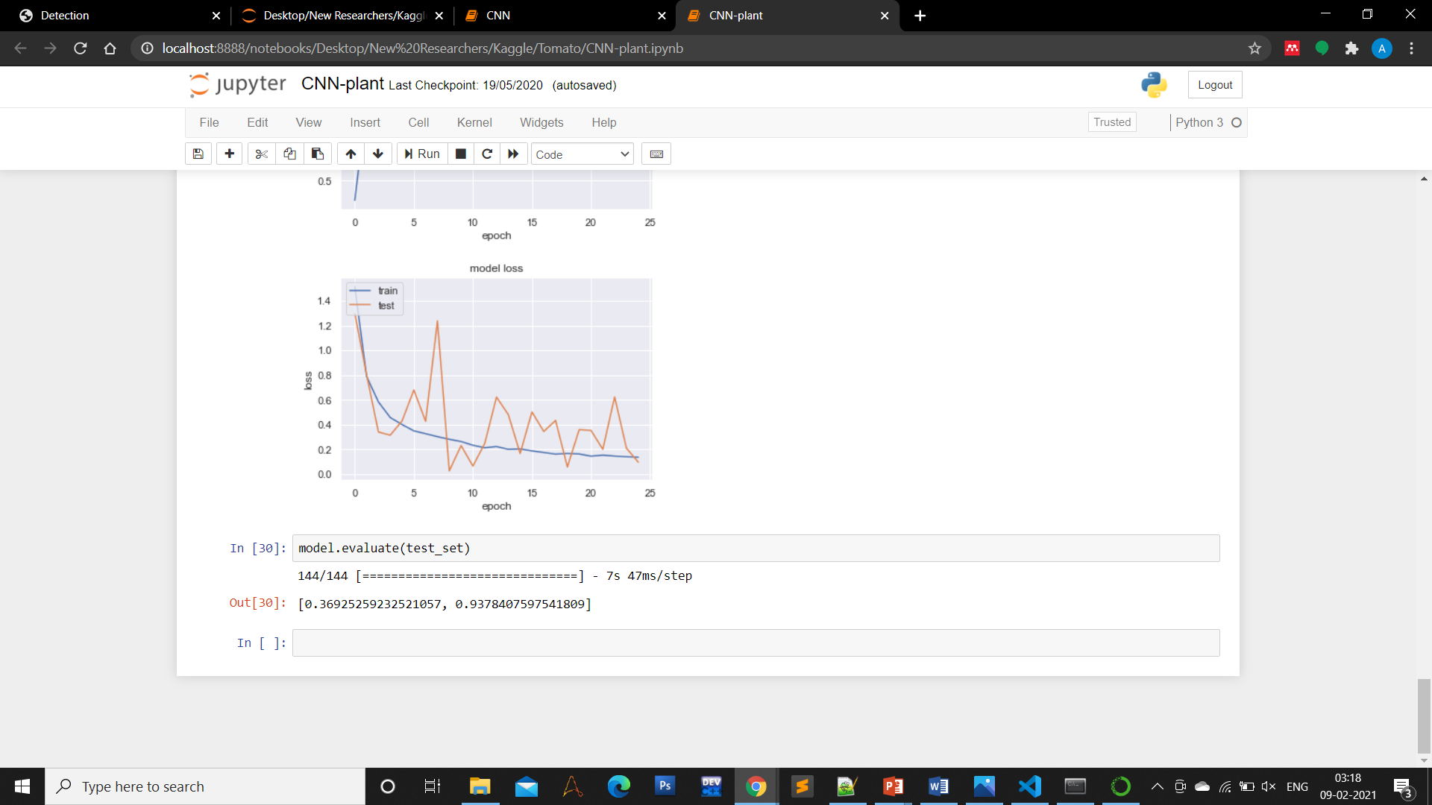
Model Evaluation
Plotting the Model Accuracy and Loss
Evaluating The Model Accuracy
Accuracy Achieved : 93.78%

Slide 11
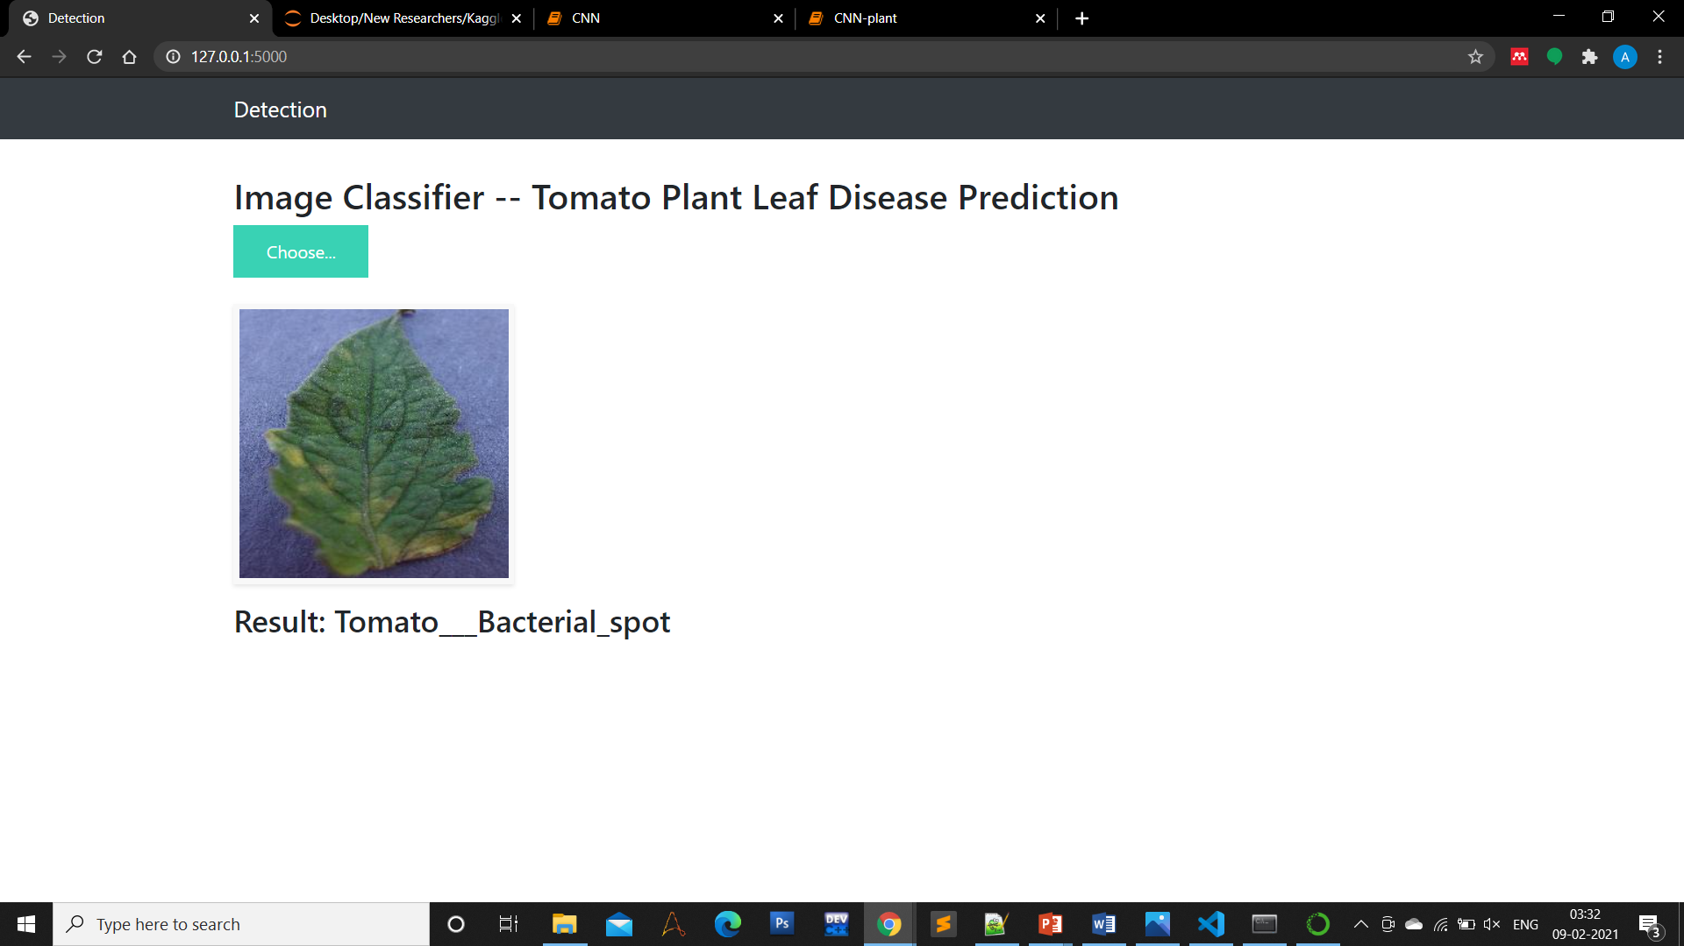
Model Deployment

Slide 12

Our Moto !!!
FAILURE IS A
MASSIVE PART
OF BEING
ABLE TO BE
SUCCESSFULL

